Slide 1
Only4
Product name: Jumperman

Slide 2





Game Mechanics
ENEMIES
PLAYER MOVEMENT
JUMP
TILES
LEFT
RIGHT

Slide 3
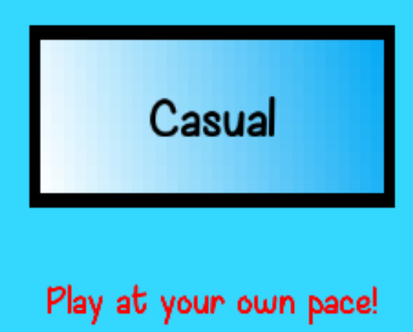
Casual Mode [Objective based]
Player reach the Golden Tile

Slide 4

02. Competitive Mode [Time Attack]
Clear all stages within 10 minutes

Slide 5
Demo

Slide 6
What went wrong?
Animation
Misunderstanding
Animation feature was slightly behind time
Misunderstanding of project
structure

Slide 7
What went right?
Quality of Code
Milestone
Reusable code
Met milestone

Slide 8
What can be improved?
More interactive tile
Expanded play area

Slide 9
Thank you

